Slide 1
Payment Request Resource Training

Slide 2
What are Payment Request?
The Payment Request form may be used for:
Invoices less than $600, that are *NOT*recurring
Miscellaneous reimbursements (out of pocket expenses that are *NOT*Travel)
R*Stars Payments
Honorariums
Stipends
Refunds of Revenue
Memberships/Registrations (where the P-Card is not accepted)
Student Cultural Events
Notes:
The Payment Request form in the Paw Procurement System (PPS)is one of several ways to make a purchase or issue a payment.

Slide 3
As well as….
Payments for greater then $600
Legal Services
Repairs
Vehicle Repair
Security Services
Much more

Slide 4
Approver
The electronic delegated approvers in PAW are able to approve all items in their department.
When establishing electronic authorizations, the State requires that we ensure:
Proper review procedures are in place to prevent, detect or correct errors and irregularities. Reviews should be made for validity, completeness, authorization, accuracy and proper classification.
Proper authorization of transaction (approval paths) should specifically delineate the lines of authority from the highest to the lowest level position.
Notes:
There is segregation between the requestor and the approver, however, there is no system requirement that the approver is anyone other then simply not the requestor.

Slide 5
Comprehensive Guidance
This guidance is designed to facilitate the efficient processing of Payment Request
Ensure appropriate and consistent internal controls and review

Slide 6
What resources are available?
Payment Request Requirements Table
Updated Frequently Asked Questions (FAQs)
Forms Overview
Standard Forms

Slide 7
Payment Request Requirements Table
Located on the financial services website.
The table details each type of transaction normally processed with a payment request as well as the supporting documentation needed.

Slide 8
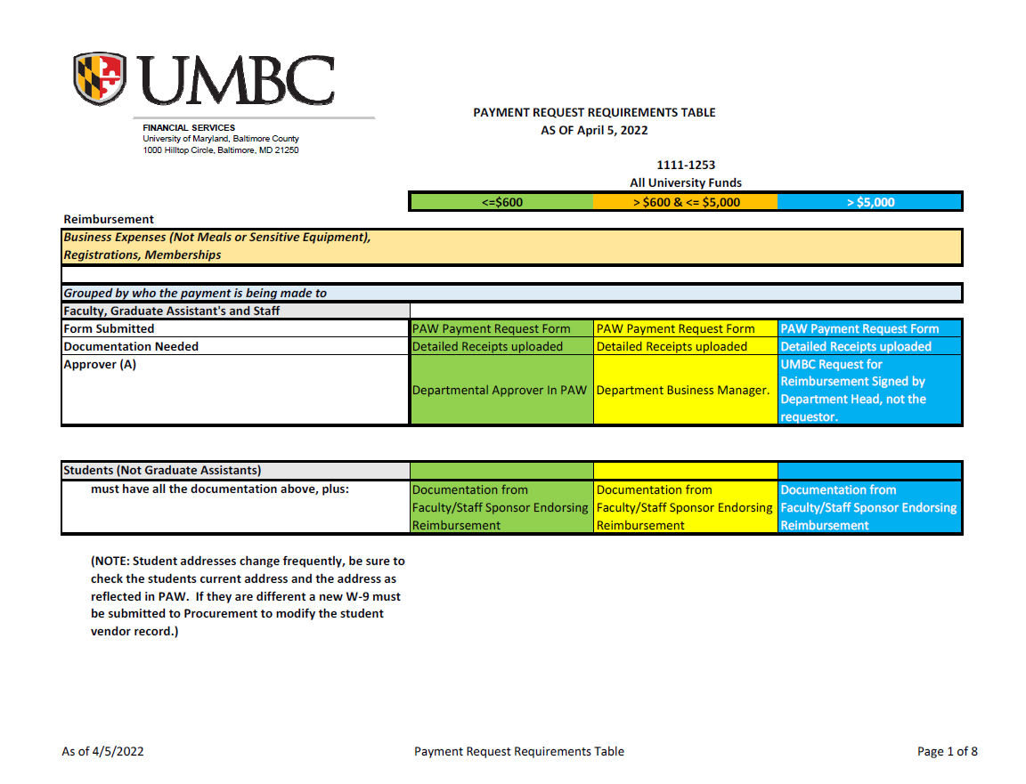
Payment Request Requirements Table

Slide 9
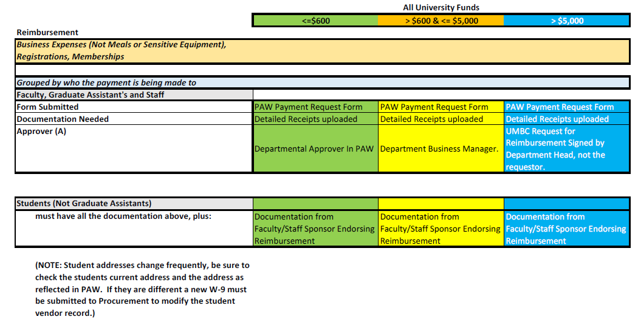
How to read the requirements table?

Slide 10
Payment Request Frequently Asked Questions (FAQs)
Located on the Financial Services website.
The FAQs address common questions regarding payment request that are not expressly addressed in the Payment Request Requirements Table

Slide 11
Some of our FAQs
We delegated authorization to our department administrator in PAW, why do we have to supply additional levels of authorization for certain transactions?
How much will UMBC reimburse me for meal expenses?
Our department is hosting a recruiting candidate, do we still need the request for reimbursement form?
What information should be included on an invoice when we submit it for payment?
I can’t find the original invoice, can I submit the statement I received for payment?

Slide 12
FAQ Updates
Please submit questions as you have them.
The FAQs will be maintained on a regular basis.
Notes:
Add Contact for FAQ submission

Slide 13
Forms Overview
The Forms Over View is located on the financial services website here:
The purpose of the forms overview is to provide a single reference for all the forms used in the payment request process, their purpose and if you can substitute a different document in place of the form.

Slide 14
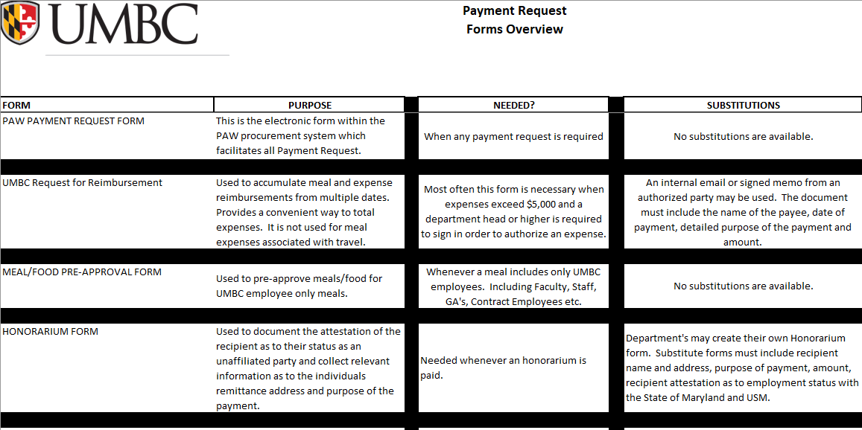
Forms Overview

Slide 15
Forms Used For Payment Request
The forms used during the payment request process are located on the Financial Services website at:
https://financialservices.umbc.edu/9-2forms/

