Slide 1
Payment Request
Reimbursements, Invoices & Sensitive Inventory

Slide 2
Reimbursements
Business Expenses
Registrations
Memberships

Slide 3
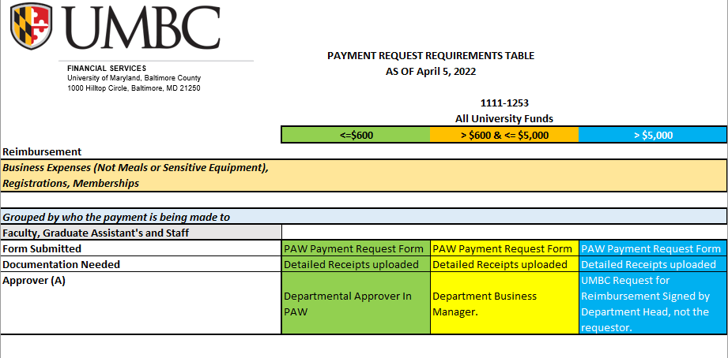
Reimbursements

Slide 4
Student Reimbursements

Slide 5
NON UMBC Community Members

Slide 6
Forms

Slide 7
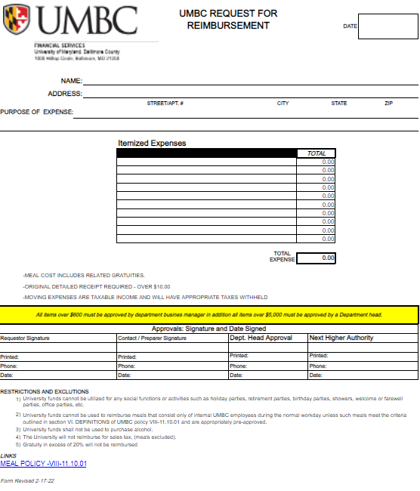
Request For Reimbursement

Slide 8
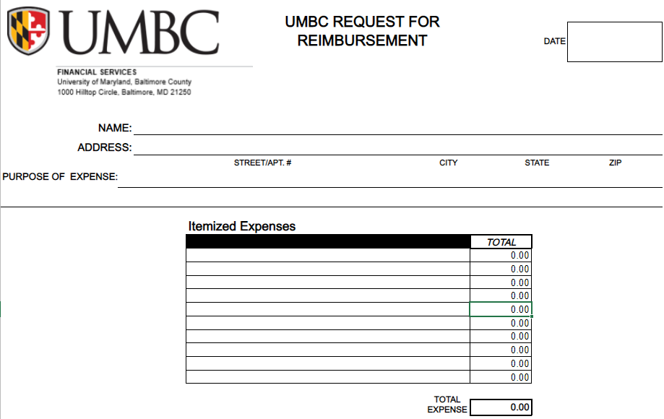
Request For Reimbursement

Slide 9
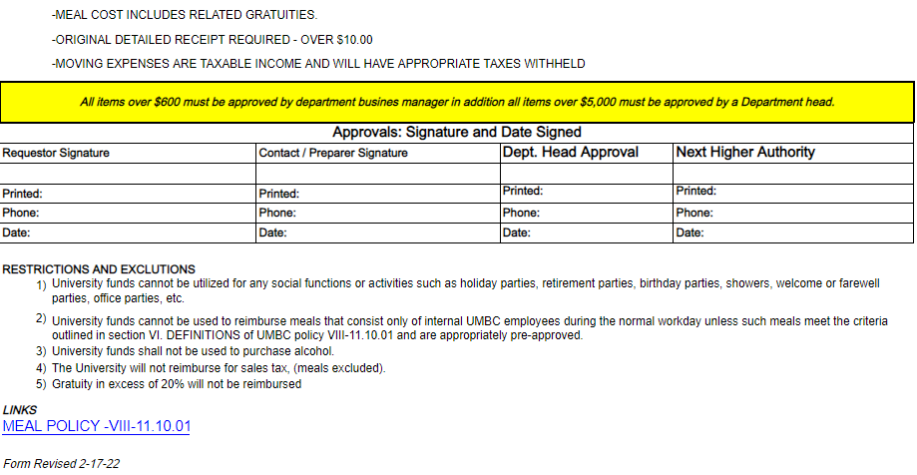

Slide 10
Invoices
Good’s and services acquired without a contract or purchase order.

Slide 11
Sensitive Inventory
UMBC associates may purchase sensitive equipment and receive reimbursement for the purchase. Associates should adhere to the same guidelines as noted above for any reimbursements based on their affiliation to the University, but in addition, proof of recordation of the sensitive equipment must also be submitted.

Slide 12
Sensitive Inventory
Defined as:
Computer equipment less than $5,000.00 per unit which includes
Desktops
Laptops
iPads, Tablets
Audio Visual Equipment with a cost greater than $1,000.00 and less than $5,000.00 per unit.
Firearms less than $5,000.00
Motor Vehicles less than $5,000.00

Slide 13
Sensitive Inventory
The University has received findings on two USM audits.
In order to address the concerns we have changed the DocuSign process for Sensitive Inventory.

Slide 14
Sensitive Inventory
DocuSign process used to end when Asset Management issues inventory tags to the custodian.
Now DocuSign ends with Custodian verifying the tags have been applied to the inventory itself.

Slide 15
Sensitive Inventory
For more detailed information on the Sensitive Inventory process please visit the Asset Management website here:
Asset Management

Slide 16
FAQ’s
What information should be included on an invoice when we submit it for payment?
Every invoice should clearly show the name and address of the State agency being billed.
UMBC
1000 Hilltop Circle Baltimore, MD 21250
The invoice must sufficiently describe the details of the goods or services being paid including the date that the goods or services were rendered and the date of the invoice.
Each invoice must contain the vendor’s name, remittance address and federal taxpayer identification number or, if owned by an individual, his/her social security number.

Slide 17
FAQ’s
I can’t find the original invoice, can I submit the statement I received for payment?
Statements cannot be used as documentation to substantiate a payment. If you are unable to locate the vendor invoice you should contact the vendor directly and ask for a duplicate invoice.
Upon submission of the invoice you must certify in writing that the duplicate should be used as an original by writing on the invoice:
Please use as original.
This invoice has not been previously paid.
______________________________________
Signature Date

Slide 18
What is the most common reason invoices are not processed quickly?

Slide 19
What is the most common reason invoices are not processed quickly?
Name and/or address does not match the W-9
When submitting any item to AP be sure the vendor information in the system (which matches the W-9 the vendor submitted) matches the invoice.

