Slide 1
Payment Request
Meals

Slide 2
Training Resources
Training Resources for Payment Request are on our Website here:

Slide 3
Meals
Excluding meals associated with UMBC travel.

Slide 4
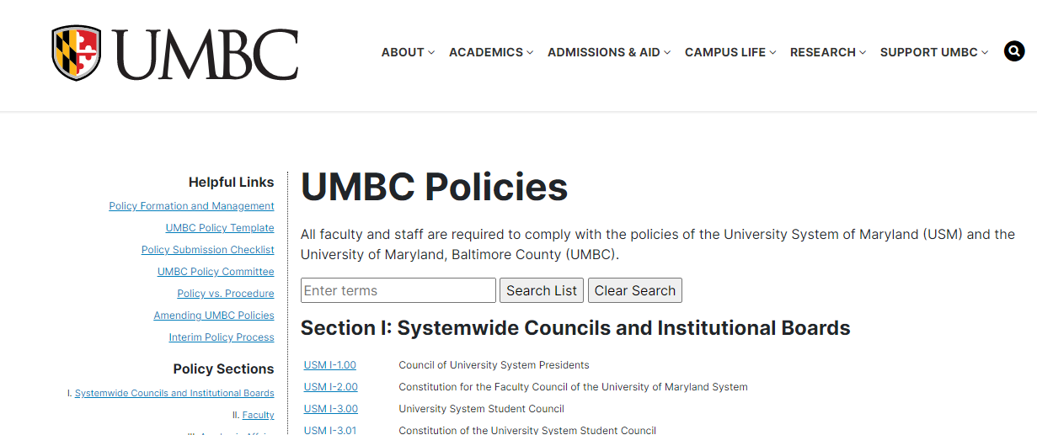
Policy
Meal Policy is located on the UMBC policy website: https://www2.umbc.edu/policies/

Slide 5
UMBC Policy
Section VIII: Fiscal and Business Affairs
Meal Policy

Slide 6
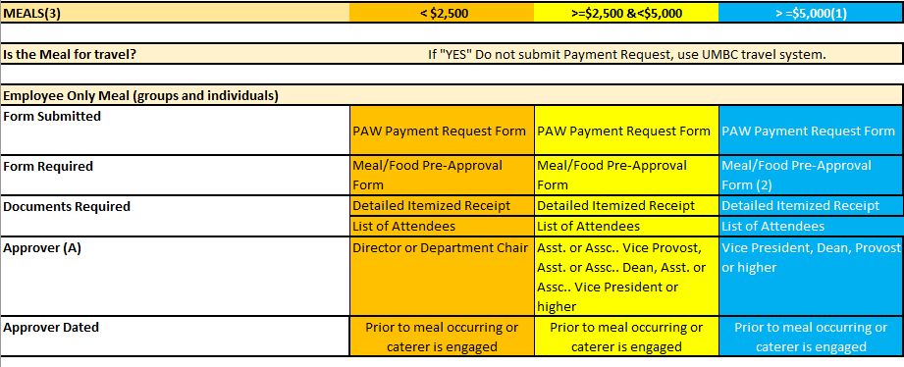
EMPLOYEE ONLY MEAL
Payment Request Requirements Table

Slide 7
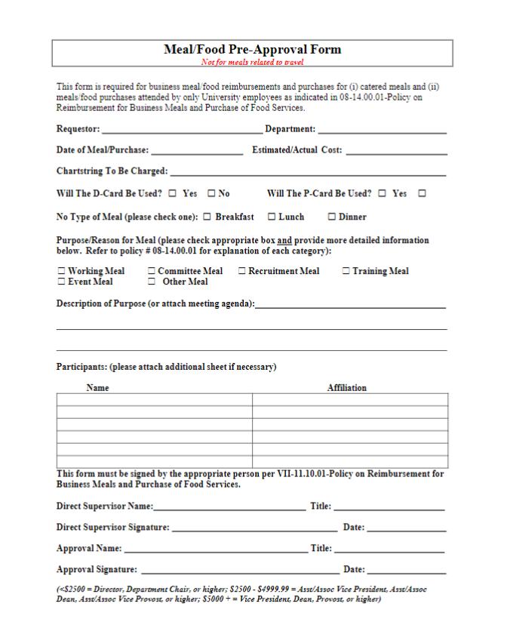
Meal Pre-Approval Form

Slide 8
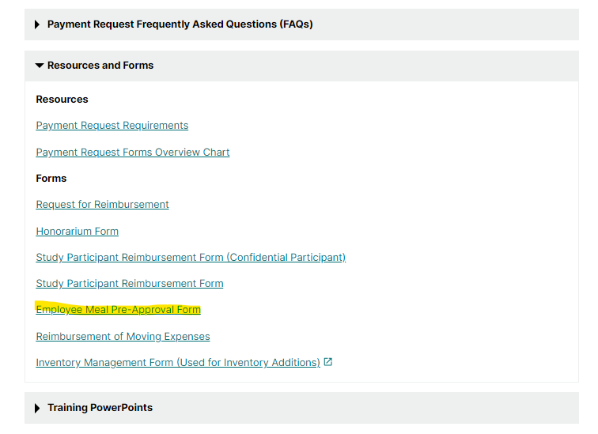
Meal Pre-Approval Form
Located on our website or Meal Pre-Approval

Slide 9
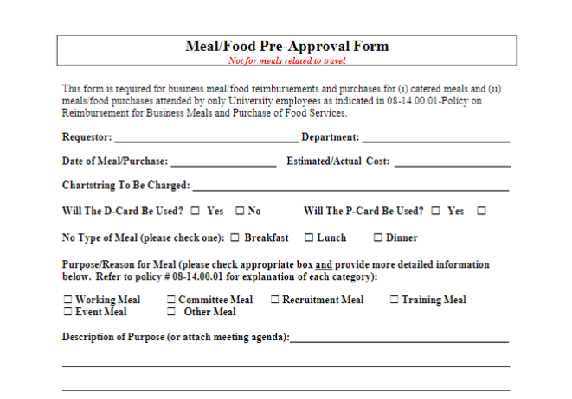
Meal Pre-Approval Form

Slide 10
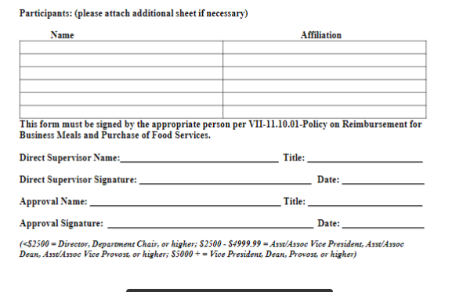
Meal Pre-Approval Form

Slide 11
Meals Including Non-UMBC Personnel
Payment Request Requirements Table

Slide 12
Meal Reimbursed for Non-UMBC Personnel

Slide 13
Important
(1) Catered events of $5,000 or more, require a competitive procurement unless the University has a contract in place for such purchases.
(2) For catered events, a requisition for a Purchase Order in Paw must also be processed with the signed Meal/Food Pre-Approval form provided to Procurement, unless the P-card can be used as identified by the Office of Procurement.
(3) For Shared Governance Groups, the Supervisor, who is to provide approval is the designee identified by the President's Office.

Slide 14
FAQ’s
How much will UMBC reimburse me for meal expenses?
Per USM policy meal expenses should normally be reimbursed based on the stated per diem rates as approved by the Chancellor on an annual basis.
The per diem rates are broken down by meal and include tax and tip.
When Faculty or Staff submit reimbursements in excess of the per diem rate it may be flagged in audit by GAD and returned for further justification. We advise campus community members to bear in mind the currently effective per diem rates when submitting meal reimbursements. Departments should be prepared to provide additional justification if reimbursements exceed per diem.

Slide 15
FAQ’s
Will I be reimbursed if I leave a tip?
The GAD guidance on tips is that no more than a 20% tip should be reimbursed. All tips up to 20%, excluding tax will be reimbursed.

Slide 16
FAQ’s
Our department is hosting a recruiting candidate, do we still need the request for reimbursement form?
Request for reimbursement forms may be omitted by the department when meals are purchased for candidate recruitments. Please submit:
Detailed Receipts
Candidate Recruitment Agenda
List of attendees to each meal

Slide 17
FAQ’s
Our department is hosting a recruiting meal for a candidate and their spouse, is the spouse's meal reimbursable?
The spouse of a candidate is not eligible for reimbursement of their meal expenses.

Slide 18
FAQ’s
What constitutes a detailed meal receipt?
Detailed receipts include a listing of all items purchased at the restaurant as well as the tip.

